Slide 1

Exploring Customer Acquisition & Retention to Maximise Revenue
Yellow Team
Mohammad, Beauchamp, Charlie, Jude, Nazmie & Rayan
Notes:
[Hello, who we are, what we are presenting]
Boil down the question and make sure the audience understands what we’re trying to get at

Slide 2
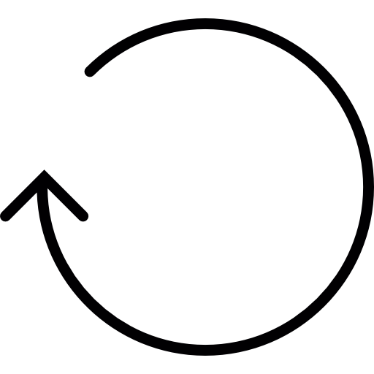

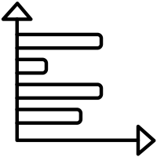
OVERVIEW
Customer Acquisition & Retention
Performance of Marketing Channels
Registered Customers
New Customers
Returning Customers
Lapsed Customers
12%
24%
64%
Referral
Direct
Organic
Avg Revenue per Transaction: £41.80
Volume: 2.1K
Insight: Low cost involved, most valuable channel
Avg Revenue per Transaction: £32.07
Volume: 85.5K
Insight: 3rd highest volume channel, returning customers
Avg Revenue per Transaction: £29.91
Volume: 265.2K
Insight: Highest volume channel, approximately double CPC volume
Notes:
First Step: Define the outline of the presentation to answer the main question
Introduce two main avenues (Customer Acq & Marketing Channels) to justify the increase in marketing expenditure

Slide 3
KPIs
Churn Rate
Churn
Rate
Customer Lifetime Value
Average
Revenue
Avg Revenue per Transaction: £32.07
Volume: 85.5K
Insight: 3rd highest volume channel, returning customers
Proportion of customers who stop purchasing over a set time period
Total worth of a customer over their lifetime
Average revenue per transaction for each marketing channel
Notes:
Introduce each KPI
Explain why it’s important in regards to customer acquisition & retention to justify the increase in marketing expenditure
Two for customer acquisition & retention, one KPI for performance of marketing channels

Slide 4
KPIs
Objective(s)
Tactic(s)
Churn Rate
Churn
Rate
Proportion of customers who stop purchasing over a set time period
Carry out a number of recommendations based on KPIs by focusing on our best marketing channels
Improve & invest in customer acquisition and retention effectively
Customer Lifetime Value
Total worth of a customer over their lifetime
Average
Revenue
Average revenue per transaction for each marketing channel
Notes:
Introduce each KPI
Explain why it’s important in regards to customer acquisition & retention to justify the increase in marketing expenditure
Two for customer acquisition & retention, one KPI for performance of marketing channels

Slide 5
Assumptions
Guest customers not accounted for as we cannot track customer history
Positive churn rates used for the TRUE customer LTV
https://baremetrics.com/blog/ltv-why-youre-measuring-ltv-wrong
Limitations
No true customer acquisition / marketing cost data
Our method for analysing customer retention and acquisition restricts the use of a slider to look at data over time
Notes:
We made a unanimous decision to ignore guest customers with good reason, but we believe the segmentation created is still incredibly valuable
We believe the tally score resulted from our RFM model would have similar KPI values assigned and such we have grouped these segments accordingly
We are assuming customer emails are being received, read and interacted with and not being sent to junk/spam in error

Slide 6
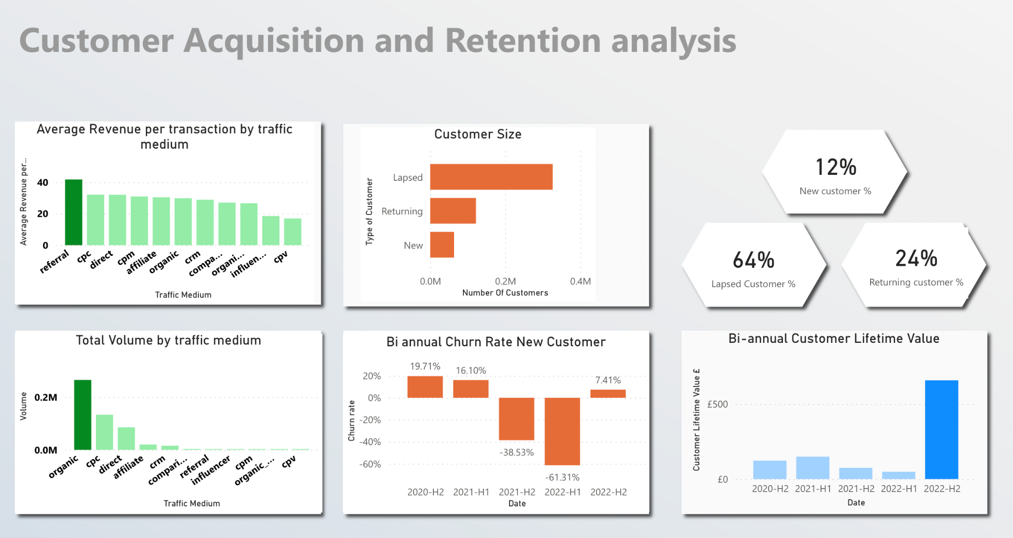
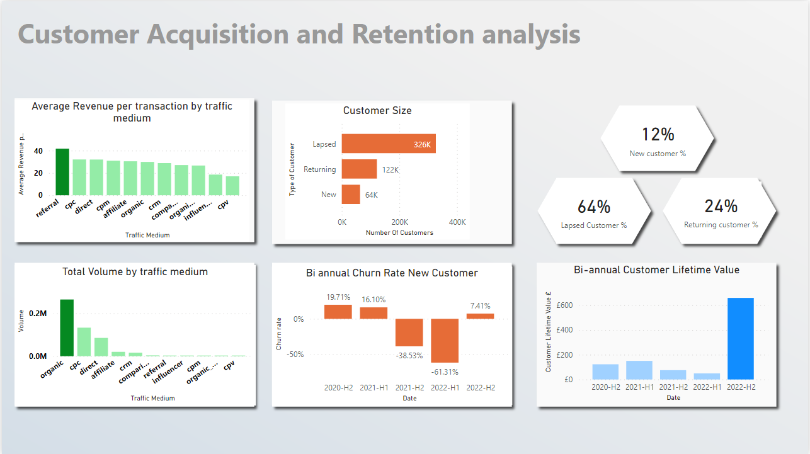

Slide 7
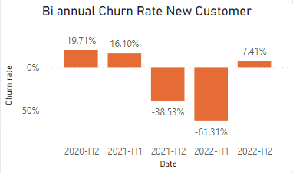
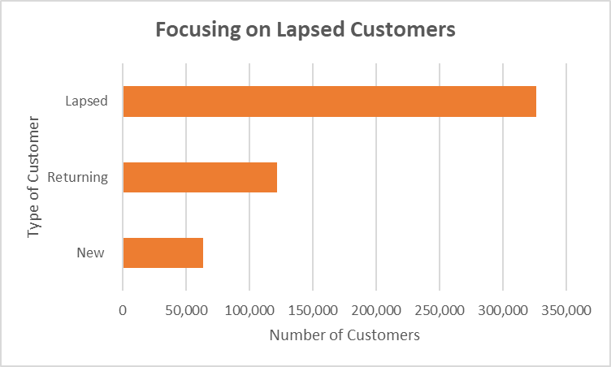
Recent Increase in Churn Rate
Recommendation:
Continue to Reduce Churn Rate - Use of A/B Testing for Email Personalisation targeted at Lapsed Customers to Encourage Re-activation
Churn Rate
Notes:
Lapsed customers are majority.
82-95% of unhappy customers will come back if impressed with your win back efforts and performed in a timely fashion. Furthermore, those customers will go on to refer, on average, five new customers.

Slide 8
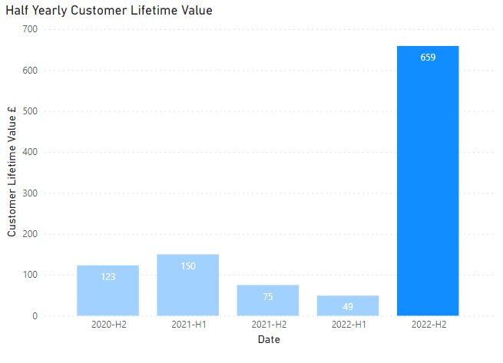
LTV for New Customers
Low LTV (for new customers) over the majority of trading years
Likely that a large % of new customers churn instantly so the lower values are not surprising
Recommendations:
Offer reduced cross-selling based on season
Reduce response times to feedback
Notes:
Introduce each KPI
Explain why it’s important in regards to customer acquisition & retention to justify the increase in marketing expenditure
Two for customer acquisition & retention, one KPI for performance of marketing channels

Slide 9
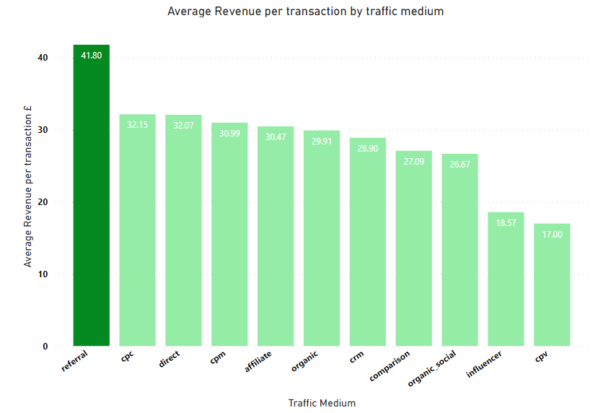
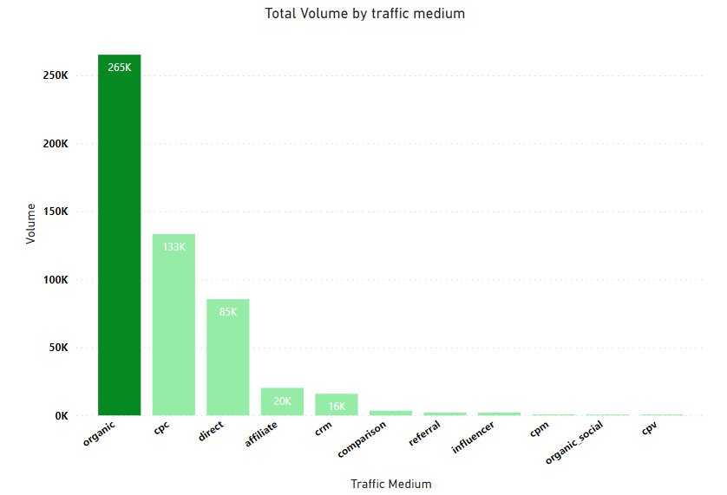
Which Form of Acquisition is Most Effective?
Organic Search - £29.91 (#6)
Volume: 265.2K (#1)
Insight: Highest volume channel, approximately double CPC’s volume
Referral - £41.80 (#1)
Volume: 2.1K (#7)
Insight: Low cost involved, most valuable channel
Direct Hyperlink- £32.07 (#3)
Volume: 85.5K (#3)
Insight: 3rd highest volume channel, returning customers
Recommendation:
Reduce CPC Marketing Spend and Redirect Funding to SEO
Only 7.5% greater AR/T than Organic Search with half the Volume
SEO is Cheaper than CPC (34% of the price on average) and Generates 85% More Revenue than CPC
Notes:
Earlier we mentioned marketing channels and the 3 that we will be highlighting
The first of these is the organic search channel
Our biggest channel, approximately 50% of all purchases come through this channel
The 6th most valuable channel in terms of average purchase per transaction
We recommend that we redirect current spend on CPC into search engine optimisation in order to cut back on costs
CPC is only 7.5% more valuable per transaction and the fact that SEO is a third of the cost of CPC this will be negated
Currently Organic search generates 85% more revenue than CPC and we believe we can push this higher

Slide 10
Which Form of Retention is Most Effective?
Organic Search - £29.91 (#6)
Volume: 265.2K (#1)
Insight: Highest volume channel, approximately double CPC’s volume
Referral - £41.80 (#1)
Volume: 2.1K (#7)
Insight: Low cost involved, most valuable channel
Direct Hyperlink - £32.07 (#3)
Volume: 85.5K (#3)
Insight: 3rd highest volume channel, returning customers
Recommendation:
Improve Referral Model (Only 0.6% of Revenue):
Add Reminders on Site and in Emails,
Customers With 2 Successful Referrals Receive Access to Exclusive Content - 24 Hour Presale of New Releases
Notes:
The second channel we want to highlight is the referral channel
The number 1 most valuable channel but only our 7th most frequently used channel for purchases generating only 0.6% of revenue
We recommend that Prism improve our model for referral, we want to add reminders on site and in emails to get our customers engaged in referrals, we also want to develop a scheme where customers with 2 successful referrals will receive access to exclusive content such as a 24 hour presale of new releases

Slide 11
Which Form of Retention is Most Effective?
Organic Search - £29.91 (#6)
Volume: 265.2K (#1)
Insight: Highest volume channel, approximately double CPC’s volume
Referral - £41.80 (#1)
Volume: 2.1K (#7)
Insight: Low cost involved, most valuable channel
Direct Hyperlink - £32.07 (#3)
Volume: 85.5K (#3)
Insight: 3rd highest volume channel, returning customers
Recommendation:
Survey Prism’s Existing Customer Base to Understand What is Going Right and What is Going Wrong
82-95% of unhappy customers will return if impressed with winback efforts performed in a timely fashion (Source: US Department of Consumer Affairs)
Notes:
The final channel we want to highlight is the direct channel
This is essentially our pound for pound champion
Ranking at number 3 on volume and value
Mostly captures our registered users and returning customers
We want to build a survey to get our customers opinion on what we’re doing well and what is going wrong on our site

Slide 12
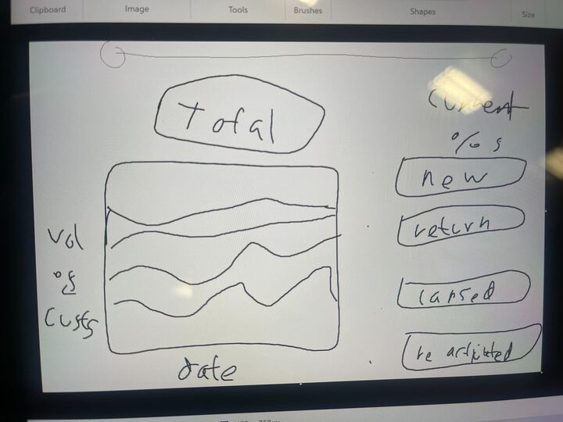

Slide 13
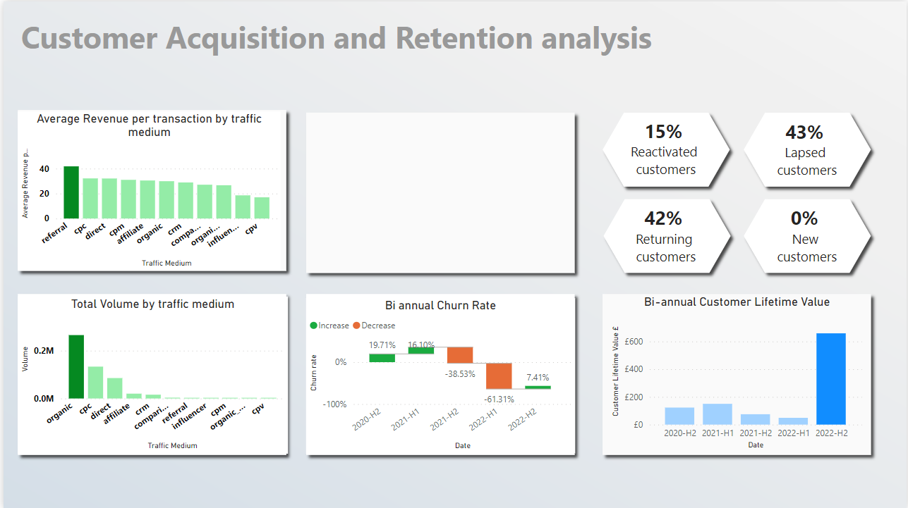

Slide 14
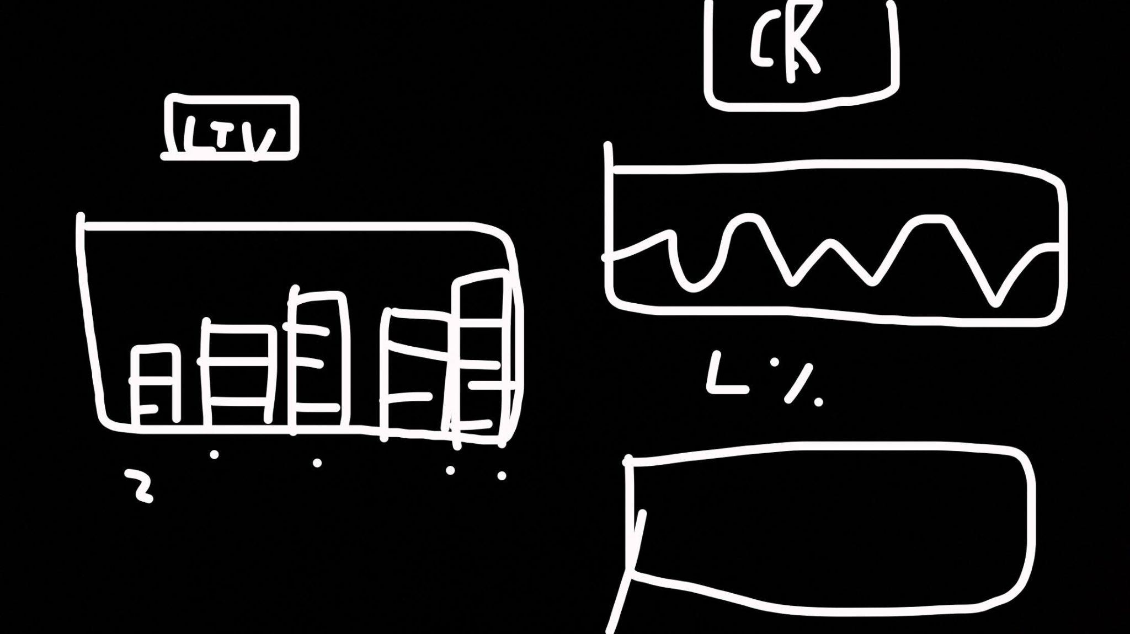

Slide 15
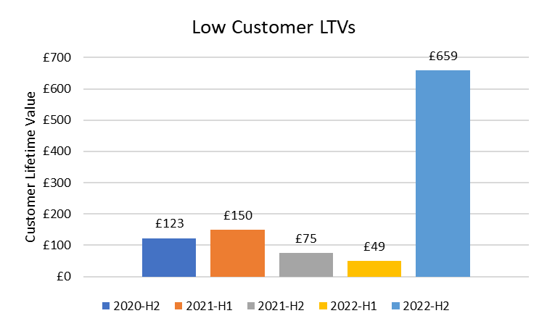
What is Prism’s Most Effective Marketing Channel?
Referral
Direct
Organic
Avg Revenue per Transaction: £41.80
Volume: 2.1K
Insight: Low cost involved, most valuable channel
Avg Revenue per Transaction: £32.07
Volume: 85.5K
Insight: 3rd highest volume channel, returning customers
Avg Revenue per Transaction: £29.91
Volume: 265.2K
Insight: Highest volume channel, approximately double CPC volume
Notes:
To understand how effective our current marketing strategy has been we can look at the average revenue per transaction relative to the channel through which the customers have been able to access the site
I want to highlight these three channels as the ones which are the most relevant to the problem of the marketing spend being too large and potential solutions for this issue while still generating a good ROI

Slide 16
Our Recommended Next Steps: Acquisition
New Customers:
Reduce CPC Marketing Spend and Redirect to SEO
Only 7.5% greater AR/T than Organic Search with half the Volume
SEO is a Cheaper Option and Generates 85% More Revenue than CPC

Slide 17
Our Recommended Next Steps: Retention
Lapsed Customers:
Reduce Churn Rate - Use of A/B Testing for Email Personalisation targeted at Lapsed Customers to Encourage Re-activation
Survey Prism’s Existing Customer Base to Understand What is Going Right and What is Going Wrong
Improve Referral Scheme - Add Reminders on Site and in Emails, Customers With 2 Successful Referrals Receive Access to Exclusive Content

Slide 18
Thank you
Questions & Feedback welcome

Slide 19
Appendix
Our Workings - Google Excel Sheets:
https://docs.google.com/spreadsheets/d/1OyFrnq1vV9_odr3NtXRnpsX2KiDkNA344s3W9BN_Vf0/edit#gid=0
Our Power BI Dashboard:
https://rb.gy/v2pr

